Slide 1
Evolutionary Architecture patterns for Building Modern Commerce applications for Enterprises
MICROSERVICES || CONTAINERIZATION || DEV OPS || CLOUD || OPENSTACK ECOSYSTEM

Slide 2

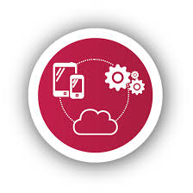

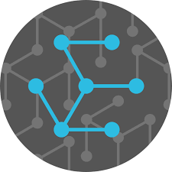
A Paradigm Shift in Retailing
Traditional transaction based ecommerce model to customer centric Omni-channel model focused on improving customer experience
“System of Records to System of Engagement” leading towards API based architectural evolution / Microservices architecture.
Retail Paradigm Shift
Hybrid architecture with customer experience solutions based on next gen technologies
Monolithic architecture broken down to distributed and decentralized services platform providing highly scalable and flexible systems with reduced licensing costs

Slide 3

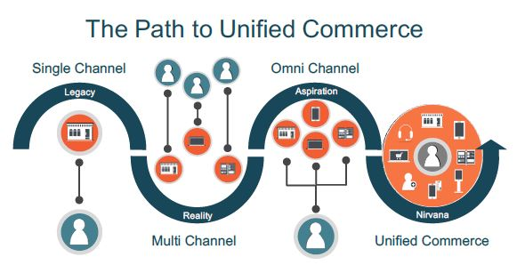
Evolving trends in Online Retail landscape
eCommerce
Omni channel
Retail
Integrated channels delivers
consistent branded customer experience
Commerce systems are maturing in support of “new business models” and transformation from “system of records to system of engagement “
Multichannel
retail
Connected
Retail
single view of
customer, product, inventory
Siloed channel
Development processes maturity
Waterfall /
Iterative
methodologies
Basic Agile and Scrum
methodology
Distributed/
Scaled agile development methodologies
CI/CD focus with emphasis on automation
Dev Ops
+
Micro service
maturity
Longer Build & deploy cycle ( 6 – 12 months)
“Big Bang” integration approach
Moderate Build & deploy cycle
( 4 – 6 weeks)
Incremental Delivery
Synchronized Delivery across enterprise
Shortened cycles (2-3 week)
360 degree traceability
Micro releases approach
Domain driven design methodologies
Container based development
Standardization of processes, methods, approaches and tools into a consistent and coordinated model

Slide 4
Evolving Architecture patterns
API Services based architecture
Loosely coupled framework
Improved customer experience across channels through common API services
Open API based Architecture
SaaS/Product based eCommerce
Platform based solution
Faster implementation
Innovation and Agility is limited to available extension points in framework
Serverless FaaS
Architecture
Micro Services Architecture
Separation of Applications - Browse and Commerce
Cloud computing code execution model
Requests are billed by an abstract measure of the resources required to satisfy the request rather than per virtual machine, per hour
Language agnostic Micro business Services based architecture
Decoupled framework
Adopt new business strategy easily beyond enterprise
Homegrown eCommerce
Agility for incremental delivery
Better scalability
Enhanced deployment patterns
Loosely coupled framework with separation of concerns
Built for specific client need
Longer implementation time
Higher cost to keep in synch with security, PI and other compliance needs

Slide 5

Microservices as an important element of the overall IoT Strategy
IoT Strategy demands realized by Microservices
Dynamism of deployment
Auto Scalability
“Do one thing and do it well”
Collection of services, representing a specific function
Heterogeneity derived form various services
Value added applications from a multitude of services
Notes:
IoT needs applications to be put together from a set of small and independent services.
Cloud-hosted microservices would create an IoT model that’s a collection of services, representing a specific function.
Microservices also offer a way of scaling the infrastructure both horizontally and vertically giving long term benefits to the IoT deployments.
Creating value added services would require to freely combine services of different vendors to fully make use of the IoT's heterogeneity
Many of the requirements in microservices are similar to those of the internet of things
IoT applications adopts several of the design decisions of microservices architecture to improve the ability to create value added applications from a multitude of services.

Slide 6
Microservices Architecture – The New Building Block of Retail Technology

Slide 7
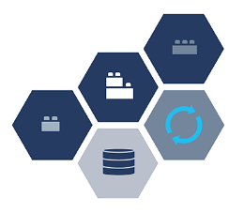
Microservice Architectural style
Industry is opting to unify the variety of systems, languages and tools in their environment and apply the level of control, security or freedom required for their business
Key characteristics
Loosely coupled small services
Light weight communication mechanism
Independently deployable services
Organized around Business capabilities
Decentralized Governance and Data Management
Smart endpoints and dumb pipes
A Microservice architecture builds software as suites of collaborating services.
Shorter time to results with increased flexibility/Scalability
Replace small pieces instead of a complete application
Notes:
Developing single application as a suite of loosely coupled Small services, each running in its OWN process
Light weight communication mechanism, often an HTTP resource API
Independently deployable services, might use different coding languages and databases
Organized around Business capabilities
Decentralized Governance and Data Management
Smart endpoints and dumb pipes
Infrastructure Automation & Evolutionary Design

Slide 8
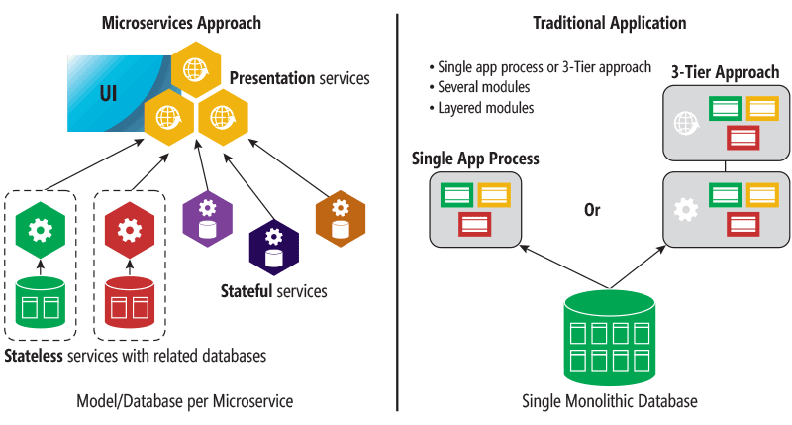
Monolithic Vs Microservices Application Development Approach
Notes:
A monolithic app contains domain-specific functionality and is normally divided by functional layers, such as web, business, and data.
You scale a monolithic app by cloning it on multiple servers/virtual machines/containers.
A microservice application separates functionality into separate smaller services.
The microservices approach scales out by deploying each service independently, creating instances of these services across servers/virtual machines/containers

Slide 9
How does Microservices Outshine Monoliths?
Capability | Traditional Monolithic Architecture | Next Gen Microservices Architecture
Operational agility | Difficult to achieve in the repeated deployment | Independent and speeds development
Scaling | Often a Challenge with scaling the entire application | Scaled independently of other services
Re-usability | Limited re-use is realized | Exposed with a standard protocol offers high reusability
Resiliency | Single Point of failure and limited or no fault isolation | Eliminates an application’s susceptibility to a single point of failure
Application Complexity | Often Evolves into a “big ball of mud” | Loosely Coupled Small Services
Development stack | Limit the availability of “the right tool for the job” | Usage of appropriate development framework for the task
Deployment | Complex deployments with maintenance windows and scheduled downtimes | Blue Green Deployments with Zero Downtime of services
Revenue | Impact in revenue due to less agility and increased downtimes | Faster iterations and decreased downtime can increase revenue

Slide 10
Microservice Architecture alignment with Business
Dealt with in an agile fashion
Changes to
business
Change in
Processes or New Process
IT can respond by
re-wiring
services into new compositions
50+
Island Countries
Microservices Alignment with Business
Ease and speed with which the company can change
360 degree engagement with the customers
Ability to react to trends in
the industry
Digital engagements
with customers
Automated with the composition of microservices
Business processes and transactions
With Interoperability that standardized interfaces bring
Pick and choose best-of-breed vendor products

Slide 11
Online Services Enablement (μservices) to Support Connected Retail
Business
Challenges
Connected
Retail Objectives
μservices
Architecture
Limited & disparate channels
Lack of standarization
Deliver advanced, interactive in-store experiences
Single view of customers
Sub-optimal engagement layer
Limited connectivity in store
Stay in touch with customers across every touch point
Supreme Consistent customer experience across all channels
Low
scalability
Inconsistent data sources
Increased Agility with Simpler Deployments
Authentic and personalised engagement
Lack of Customer 360
Disparate technologies
Improved Scalability
High level of customisation
Silo approach
Harness the power of data assets
Improved fault isolation
Connected Retail – “Internal as well as the external systems of the Retail IT System needs to be connected in a way that they can communicate and interact with each other smoothly”

Slide 12

Microservice Architecture Principles
Each software module should have one and only one reason to change
Single Responsibility Principle
Abstractions should not depend upon details. Details should depend upon abstractions.
Software entities should be open for extension, but closed for modification
Dependency Inversion Principle
Open-Closed Principle
SOLID Microservices
Clients should not be forced to depend on methods they do not use
Subtypes must be substitutable for their base types
Interface Segregation Principle
Liskov Substitution Principle

Slide 13
Domain Driven design for service architecture
Domain-Driven Design (DDD) aids in the planning of Micro services Architecture and acts as fundamental tool for defining granularity of micro services
Domain Driven Design helps in four major areas while building Microservices
Strategic design
Internal building blocks
Large-scale structures
Distillation
DDD concepts can mitigate against ubiquitous language complexity in micro-service environments
Notes:
DDD can help in four major areas when building micro services:
Strategic design which is mainly about Bounded context, but Context map and other patterns are also important.
Internal building blocks, using tactical patterns like entities, aggregates and repositories when designing the internals of a bounded context.
Large-scale structures for creating a structure using evolving order and responsibility layers.
Distillation with ways to distil a core domain from an already grown system.

Slide 14

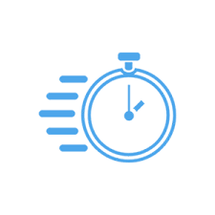

Containerization helps business move up the Value chain with better agility
Abstraction
Agility
Reduce Infrastructure Costs
Creating the ability to build once and deploy anywhere.
The ability to build, iterate and deploy applications and workloads faster.
Through better utilization of infrastructure by using containers, clients see a 30-50% savings

Slide 15
DevOps is critical to successfully adopting Microservices
Micro services
Containerization
Devops
DevOps Will Move Up the Stack to Business Value
Business agility is one of the key business drivers for adopting microservices
Incremental and more frequent delivery of new capabilities drives the need for organizations to adopt DevOps practices
Microservices architecture results in frequent and greater numbers of smaller applications being deployed.
Automated DevOps facilitates frequent deployments, and scale to handle growing number of microservices deployments
In a DevOps environment, developers can independently deploy each service, which helps with fault isolation
15

Slide 16
Benefits of using Microservices
Developer perspective
Tester perspective
Avoiding large code base
Simplified Code dependency tracking
Improved deployment times
Complete ownership by a self-contained single team
Improved productivity
Independent testing
Eliminates ripple effect with regards to regression testing
Business owner perspective
Service management perspective
Agility to respond to new customer and market needs
More frequent delivery and faster delivery times.
Better user experience by enabling to scale individual microservice
Minimum centralized governance
Duplicate services elimination,
Reduced development expense
Lower operational management costs

Slide 17


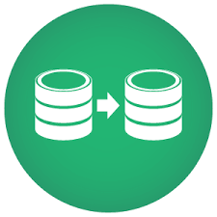



Where Do Microservices Go Amiss and What Can be Done?
Key Area
Challenges with Microservices
Potential Solutions
Service
Discovery
Communicating between the services to create logical workflows and a complete finished product
A service discovery protocol or a centralized router
Service
Communication
Circuit breaker where one microservice realizes another is “sick” and notifies main circuit breaker.
Risk of latency when each service is brought together.
Service Separation
Dividing the application into smaller units so that there is minimum interdependency
Domain Driven Design divides and re-bundles complex domains into multiple bounded contexts
Interprocess Communication
Two Options :
a) Request/Response based
b) Event Based
Choice of mode and tool for inter-process communication
Source Code Management
Git submodules where one parent repo will have links to each microservice as a submodule
Single repo for each microservice
Need to have a session store and session sharing between microservices
Token based authentication / JWT can be a possible option
Authentication

Slide 18
Industry Adoption

Slide 19


Industry Adoption of Microservices
The Netflix Experience
Amazon
As popularized by Yegge’s Google platform rant, Amazon is regarded as the first company that got microservices and APIs right
Netflix is one of the front runner in microservices, having gone into a major redesign of their systems along microservice lines in recent years
Facebook, Walmart, Google, SoundCloud, Comcast Cable, Uber, Ebay, Karma, Groupon, Hailo, Gilt, Zalando, Capital One, Lending Club, AutoScout24
Some of the other Companies who have adopted Microservices

Slide 20
TCS Offering

Slide 21
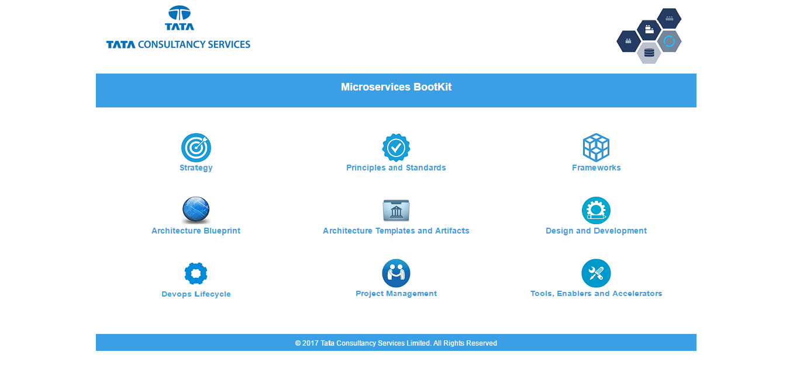
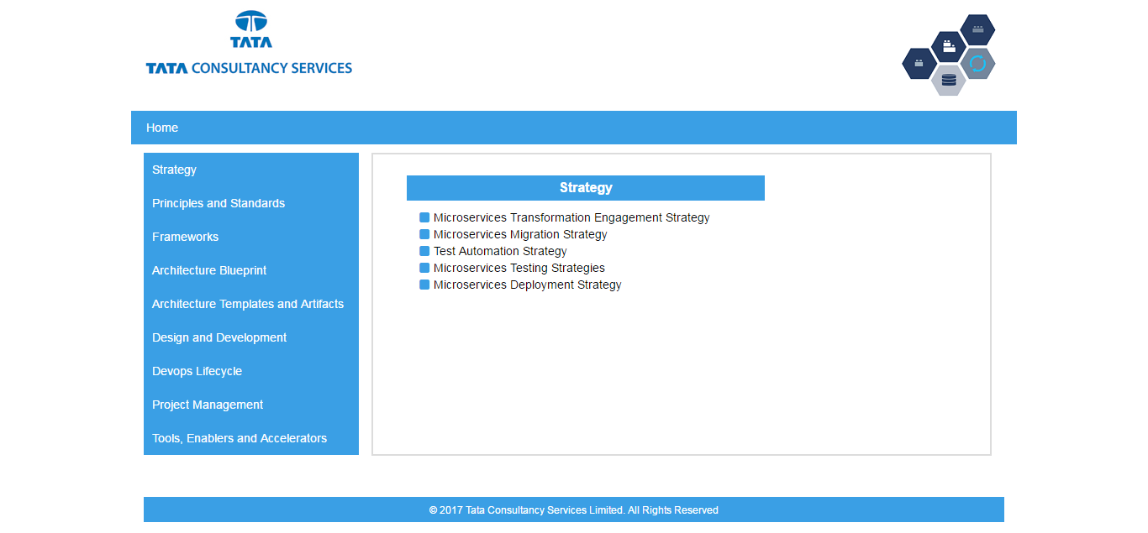
TCS’ Microservices Enablement Boot Kit
Helps customers jumpstart their Microservice implementation and ensures on-time and on-budget project delivery.

Slide 22




Microservices Architecture Blueprint – Logical Architecture based on TCS Experience
Interaction Channels
(AngularJS/ReactJS)
External API Gateway
Authentication/ Authorization Service
Service Load Balancer
Service Registry
Service Orchestration/Assembly
CMS
Business Application Services (Bounded Domain Context)
Order Services
Catalog Services
Search Services
Marketing Services
Promotion Services
Container
Container
Container
Container
Container
PIM
… Services
… Services
… Services
… Services
… Services
Third Party /Backend Integration Systems
Integration Services
Adapters
Data Services
Event Stream Processor
Event Store
Inbound
Outbound
Product
Price
Range
MQ
Sync
…
…
…
…
TAX
IT Management
Container Orchestration
22
Cluster Manager
Scheduler
SCM
Build and Deploy
Infra Automation
Operations and Monitoring

Slide 23

MICROSERVICES REFERENCE TECHNICAL ARCHITECTURE
Tier A (Web/ LB/ Reverse Proxy)
Edge Services
Security
Tier B (Service Orchestration)
Tier C(Application Services)
Tier D( Data/ Int Services)
Tier E (Data)
Tier F (Messages)
Web
server 1
Web App
oAuth Resource Server
Circuit Breaker/ Fault Tolerance
Service Load Balancer
Microservices - Docker Containers
Microservices -Docker Containers
Message Source
(3rd Party /Enterprise Systems)
HAProxy
Nginx
NodeJs
Zuul
Spring security
Hystrix
Ribbon /
Kuberenetes
Database (Mongo)
API Gateway
Catalog Service
Fallback Service
Product
Inventory
Log
Endeca / SOLR
Search Service
Fallback Service
Order
Customer
Web App
Filtering
Profile Service
Fallback Service
…
Legacy Systems
NodeJs
http/https
Web Balancer
…
oAuth Authorization Server
Microservices - Docker Containers
…
Spring security
Order Service
Fallback Service
Web
server N
Routing
Nginx
PIM
CMS
Event Stream Processing
Message Brokers (MQ)
…
Inventory Service
Fallback Service
Spring Cloud Data Flow
Web App
NodeJs
Post Processing
Shipping
Tax
Marketing Service
Fallback Service
…
…
Apache Kafka
Service Discovery
Eureka
Monitoring
Hystrix Dashboard / Turbine / ELK / Grafana / HA Top

Slide 24
TCS Expertise in Advanced Microservice Implementation Patterns
Command Query Responsibility Segregation
(CQRS)
Queries for the retrieval of information
Commands for the state changing business function like customer modifying their personal profile, or submitting an order
Event Sourcing
Changes to state are stored as journaled business and user triggered events
IoT Integration ready pattern
Domain event driven approach where microservices work asynchronously driven by domain events published to a message broker
Continuous Delivery of Composed Application
Continuously release software aligning with agile development principles
Short release cycles, fast feedback on build failures and automated deployment facilities are critical

Slide 25






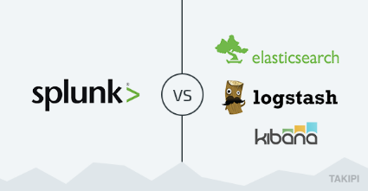









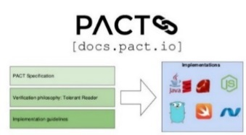


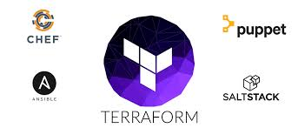


TOOL SWARM – MICROSERVICES ENABLERS
API Gateway
CICD Jenkins Pipeline
DEV
GitHub - SCM
Code Build
Cloud Hosting
Containers
Unit Testing
Monitoring
Mocking Framework
Hystrix- Circuit
Breaker
Container Orchestration
Code Quality
E2E Testing
Spring Cloud Data Flow
API Gateway/LB/Service Discovery
Contract Testing
Event Store
TERRAFORM
Infra Automation
Binary Repo
Kubernetes Package Manager
Feature Testing
Notes:
delete

Slide 26



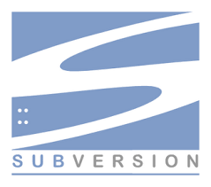


Reference Devops Pipeline Components for Microservices
Developers
Aligned to 12 Factor App Principles
CICD Jenkins Pipeline
Build Stage
Release Stage
Run Stage
SCM
Build
Test
Static Code Analysis
Code Binary Repo
Create Container
Push Container / Image Repo
Combine Container
with env config
Deploy Container (QA)
Contract Testing
E2E Testing
Cluster
Cluster Manager
PROD Deploy
Capability | SCM | Build | Unit Testing / Mock Objects | Code Quality | Artifacts / Binaries Repo | Container Creation and Image Repositoy | Run Container in Test Environment | Contract Testing | End to End Testing | Container Orchestration (Prod)
Solution | GitHub | Maven / Gradle | Junit / Mockito | SonarQube | Nexus | Docker Image, M&S Docker Registry | Kubernetes Cluster | REST Assured | Selenium / Cucumber | Kubernetes Cluster

Slide 27
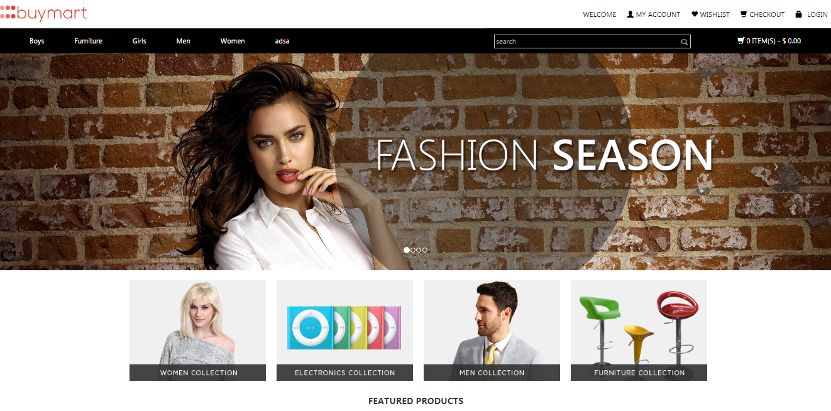

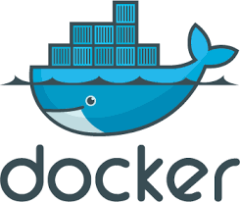
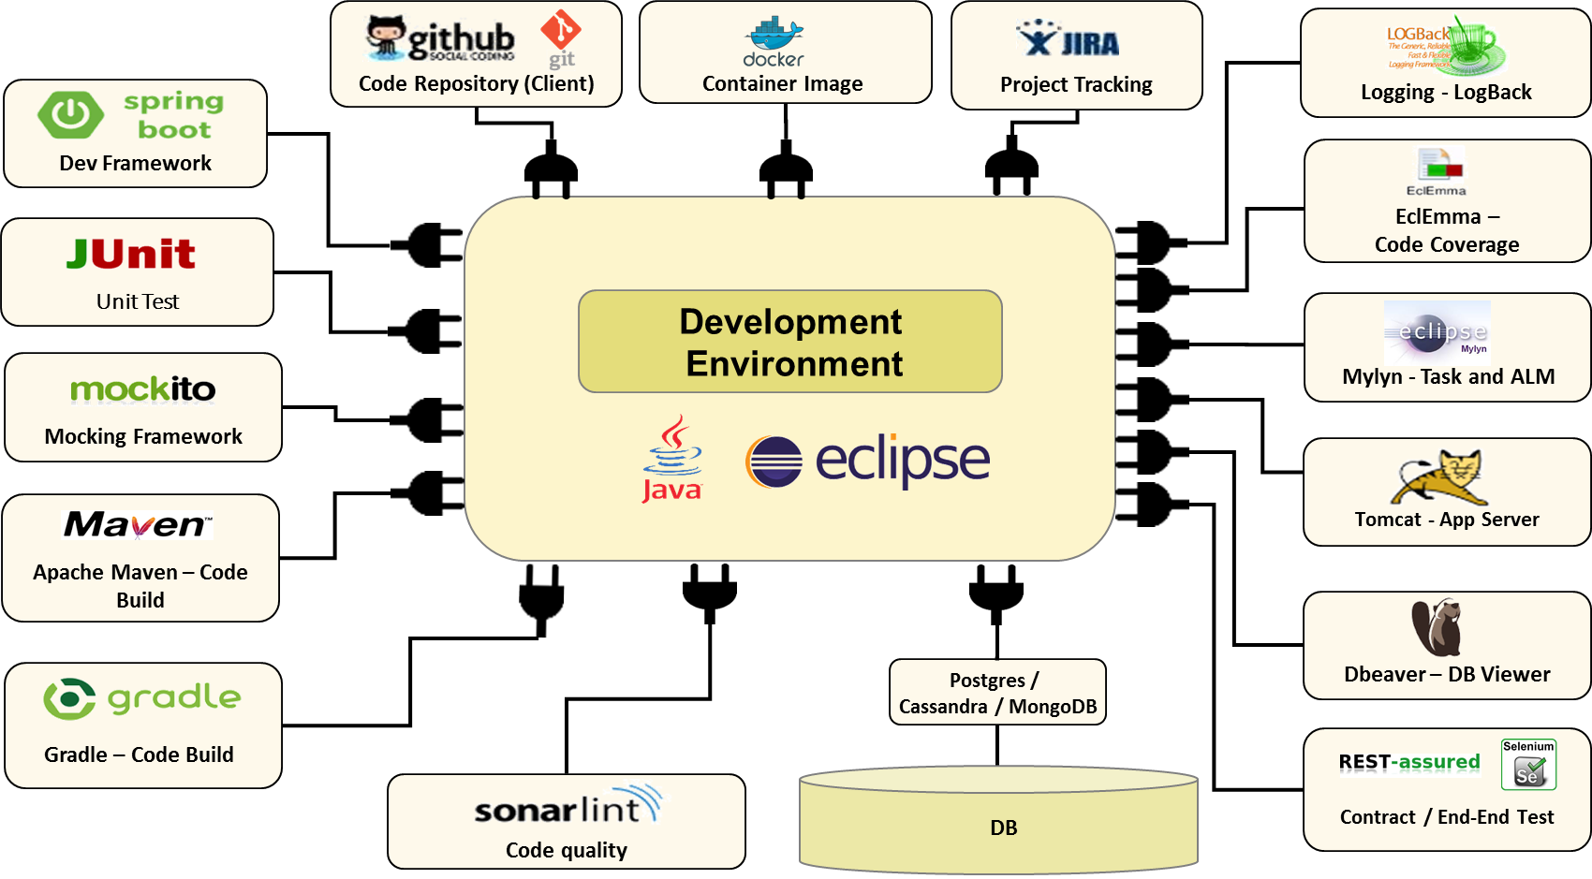
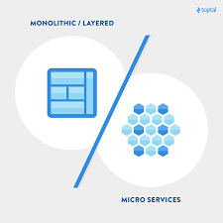
Microservices Assets and Accelerators
Microservice Reference Store
Service Catalog and API’s
Docker and Helm Templates
Ecommerce Store Accelerator built using NextGen Technologies and Microservices
Service Repository of Spring Boot and Ruby on Rails based micro services
Repo of Prebuilt Docker & Helm Kubernetes Templates for Container Orchestration
Monolithic to Microservices Migration Framework
Netflix OSS Starters
Developer Workbench
Ecommerce Monolithic to Microservices Migration Framework
Prebuilt accelerator and Configurations for enabling Netflix OSS Open Stack
Microservices Developer Workbench that enables accelerated development

Slide 28

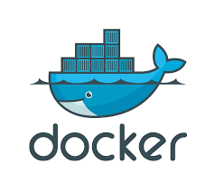
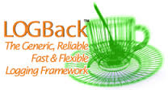

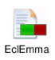













Microservices Developer Workbench – Facilitating Accelerated Development
Code Repository (Client)
Container Image
Project Tracking
Logging - LogBack
Dev Framework
EclEmma –
Code Coverage
Unit Test
Development
Environment
Mylyn - Task and ALM
Mocking Framework
Tomcat - App Server
Apache Maven – Code Build
Dbeaver – DB Viewer
Gradle – Code Build
Postgres /
Cassandra / MongoDB
Contract / End-End Test
Code quality
DB

Slide 29


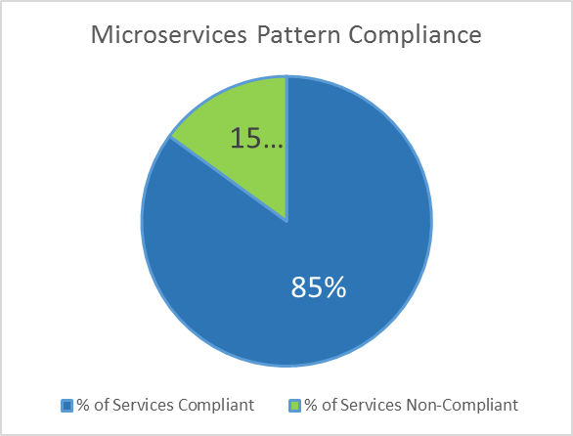

Monolithic to Microservices Migration Framework
1
2
3
4
Services identification across multiple web-forms
(Domain Driven Design)
Micro services Migration framework
Refactoring to identify the ideal Set of micro-services
Commerce Product Compatibility Analysis
Web-forms
Mobile, Web, Backend systems
DDD Tools
Context map
Anti-corruption layer (ACL)
Interchange context
Weighted Scoring model
Iterative process ensuring the
required set of granularity
are obtained – as per the defined
Micro-services Pattern Compliance Scores
5
Sophisticated & Collaborative,
Mechanism of ranking based on the level of importance and impact
Micro-services
implementation
Multi-attribute
Weighted Framework model
Micro-services Pattern
Compliance Evaluation Scores
Key Dimensions
Reusability
Extendibility
Customizability
Cacheability
> 90 % - Excellent : Meeting Standards
80% - 90% - Good : Acceptable Standards
< 80 % - Average: Need to refactor the services and bring more granularity

Slide 30
TCS Engagement Approach for Microservice Transformation
Define Scope
Capture Requirements
Develop Solutions
Implement
Capture work stream &
Discovery scope
Identify Generic, Core Business Capabilities and Requirements
Identity and select conceptual solution options
Develop Transition
Determine list of use cases in scope
Identify business contacts
Capture high level value chain
Agree criteria for selecting discovery phase use cases
Agree sub-set of use cases to be examined in discovery phase
Capture current and aspirational business capabilities and pain points
Capture as-is systems
Identify core capability required
Map against best practices
Identify gaps & opportunities
Verify with business & architects
Documents epics & userstories
Identify process & systems options to deliver required core capabilities
Map Pro's & Con's of solution options with architects
Agree short and long term solutions to deliver
Capture key decision points & risks
Documents to-be process & systems
Develop solutions Deliverables
Develop plan to implement short and long term solutions
Internal Deliverables
Use case matrix high-level value chain
Agreed criteria & sub-set of usecases
Capability matrix by use case As-is Process & system maps
Agreed core capabilities
Matrix of solution options by core capability
Agreed solutions
To be process & system maps
Epics and user stories for core capability
Architectural blueprint HLD lite
Transition plan
Project Deliverables

Slide 31
Microservices Testing Strategies
E2E Testing – Certifying the business critical functionalities and the most valued user journey scenarios
Integration Testing – Certifying the inter-dependent services/API’s are integrated successfully
Contract Testing –
Integration Contract Testing : Testing is carried out using a test double (mock or stub) that replicates a service that is to be consumed
Consumer-driven Contract Testing : Consumers define the way in which they would consume the service via service contracts
Unit Testing – Scope of unit testing is internal to the service and should be ideally automated
Mike Cohn’s Testing Pyramid
E2E Testing
Business Centric
Integration Testing
Scope of Testing
Functional Centric
Contract Testing
Unit Testing
Development
Centric
Number of Tests

Slide 32
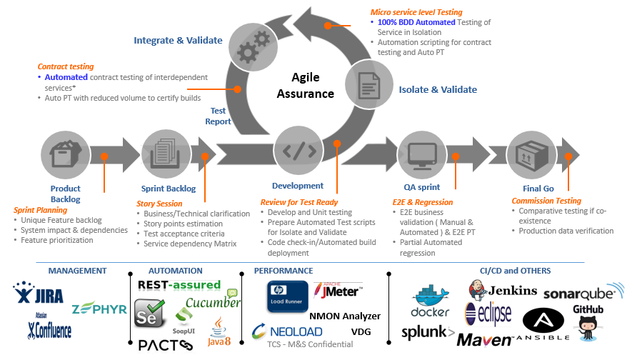
Microservices Test Automation Strategy

Slide 33
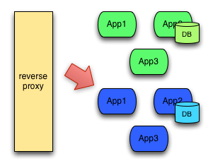
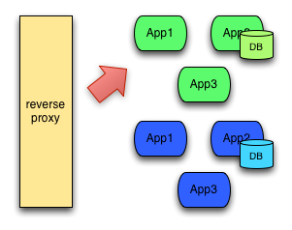
Microservices Deployment Strategy - Blue Green Deployment
Releasing the application in a predictable manner with a goal of reducing any downtime associated with a release
Kubernetes Proxy
Kubernetes Proxy

Slide 34
Microservices Migration Strategy and Roadmap
TCS Experience
TCS Framework
Based on TCS experience from engagement with leading retailers in world on open source migration
Based on TCS’ framework to assess, define and design open source migration initiative
TCS viewpoint
Re-platform Non-commerce part first followed by Commerce aspects
Phase 0
Phase I
Phase II
Phase III
Phase IV
Laying the foundation
Search | Personalization
Browse | Pricing
Account maintenance | Post-order user activity
Checkout
(API Services, New Presentation Layer)
(SOLR, Bloomreach, Zettata)
(Home page, PDP, PLP, Special Pricing and offers…)
(User Management, Order approvals, View/track orders…)
Micro Services enablement
Micro services Migration Roadmap

Slide 35
Best Practices for Building a Microservice Architecture
Service Essentials
Service Interactions
Development
Independently develop & deploy services
Services should have their own private data
Services should be small but add value
Store data in databases, not ephemeral service instances
Offload work to asynchronous workers
Layer security and don't write own crypto code!
Transport data over HTTP , serialized using JSON
Have a Service Discovery mechanism
Prefer decentralized interactions
Define Timeouts
Implement Circuit breakers
Guarantee eventual consistency
Authenticate all API calls
Use a common source control platform for all services
Either mimic prod in dev or use isolated cloud based dev environments
Push working code to mainline often
Release less, release it faster
Service templates should cover the fundamentals out of the box
Deployment
Operations
People
Use a system image for a deployment package
Have a way to automatically deploy any version of any service to any environment
Feature flags decouple code deployment from feature deployment
Configuration should be managed outside of the deployment package
Manage all logs in one place
Use a common monitoring platform for all services
Stateless services are easy to auto scale
Automation around the provisioning and management of external services (queues, caches, database, etc.)
Full Lifecycle Ownership - Service teams develop, deploy & operate their own services
Teams should be autonomous in daily operations
Two-pizza teams - Teams that can be fed with two pizzas.

Slide 36
Microservices Reference Store

Slide 37
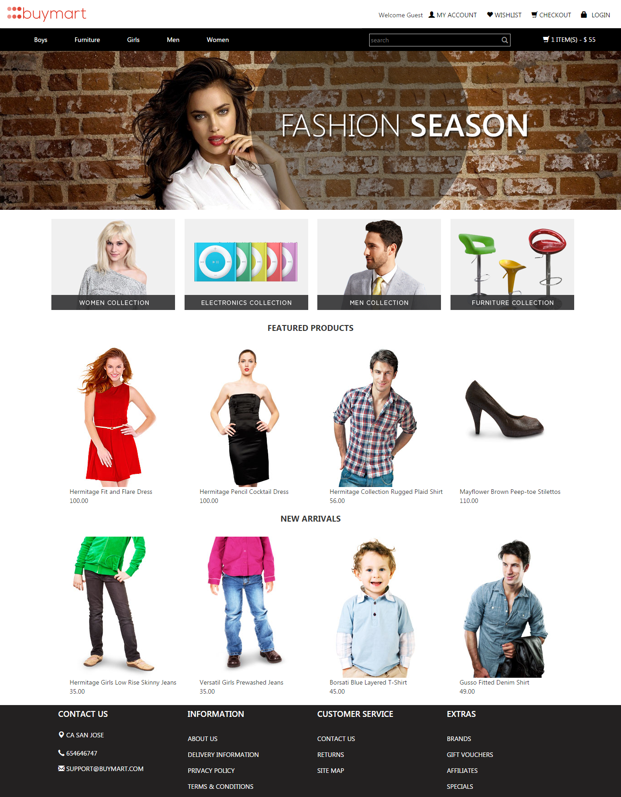
Reference Microservices Driven Ecommerce Store
Categories Service
Banners Service
MICROSERVICES
Featured Products Service
New Arrivals Service

Slide 38








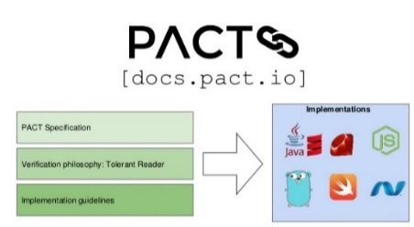





Microservices Reference Store - Devops Pipeline
Build
Develop
Commit
Compile
Unit Test
Static Code Analysis
E2E Testing
Contract Testing
Deploy / Run Container (QA)
Push Container
Build Container
Publish Artifacts
Automated or Manually Triggered
Monitoring – RELK-B
Deploy (PROD)
Load Balancer (RIBBON)
Service Registry (EUREKA)
Service Orchestration / Fault Tolerance (HYSTRIX)
API GATEWAY (ZUUL)
Container Cluster
Container Orchestration

Slide 39
Case studies

Slide 40
DIGITAL COMMERCE
CUSTOMER ENGAGEMENT
TCS’ partners with retailers globally and collaboratively work in achieving their Commerce and Digital initiatives

Slide 41

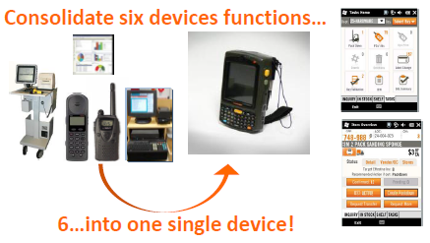



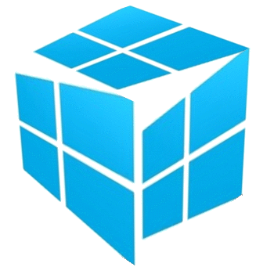

Enabling Next generation Interconnected seamless retail experience
A decade of Strategy partnership in Interconnected retail transformation journey
Architecture Transformations
Digital Customer experience
Browse & Checkout Segregation
Augmented Reality
Kitchen Planners & Visualizers
Omni-channel Fulfillment
BORIS // BOPIS // BOSS // BODFS
THD professional App
Catering to Professional customers
APIGEE
Mobility to all
Customers // Employees // In-store
Search innovations
Voice // Visual // Barcode search
Site & Checkout Redesign
Seamless customer experience
Expose services as API calls
Browse
application
Checkout application
30%
Increase in Customer Satisfaction
Tomcat
Commerce
WCS 7
35%
Growth in ecommerce Sales
Endeca Search
First Phone: Store associate enablement
Industry
Recognition
Internet Retailer of Year
2015 Award Winner
Best mobile shopping experience
Episerver's Mobile report 2015
Best Mobile App of Year
First Phone , by RIS in 2011

Slide 42
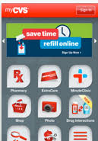



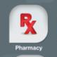

Unravelling Business Agility through Micro services enablement
Simplifying core commerce || Flexible business architecture|| Unified commerce || CX Focus
Transaction centric  Customer centric
Site Redesign & micro services enablement
ATG based traditional
Commerce architecture
Catalog as service
Account management services
Pricing & promotion services
Search services
Checkout services
Customer behavior driven personalized promotions
ATG product Upgrade
Endeca search implementation
Tightly coupled presentation layer & business logic
Non responsive storefronts
Customer experience redesign
Drug information center
Pill Identification
CX initiatives using services
Service enablement
Auto Subscription
Personalized Recommended
Weekly ad
Online appointment schedule
ExtraCare/ Rx Mgmt.
Interaction checker
Drug information center
Single view of customer
Single view of orders
Single view of loyalty
Best Consumer Health Product Internet Site Award
Platinum award for overall Web design, interactivity, integration, health content, medical care support and ease of navigation.
Monolithic architecture

Slide 43



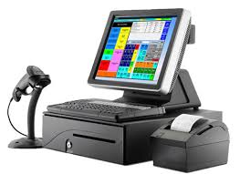


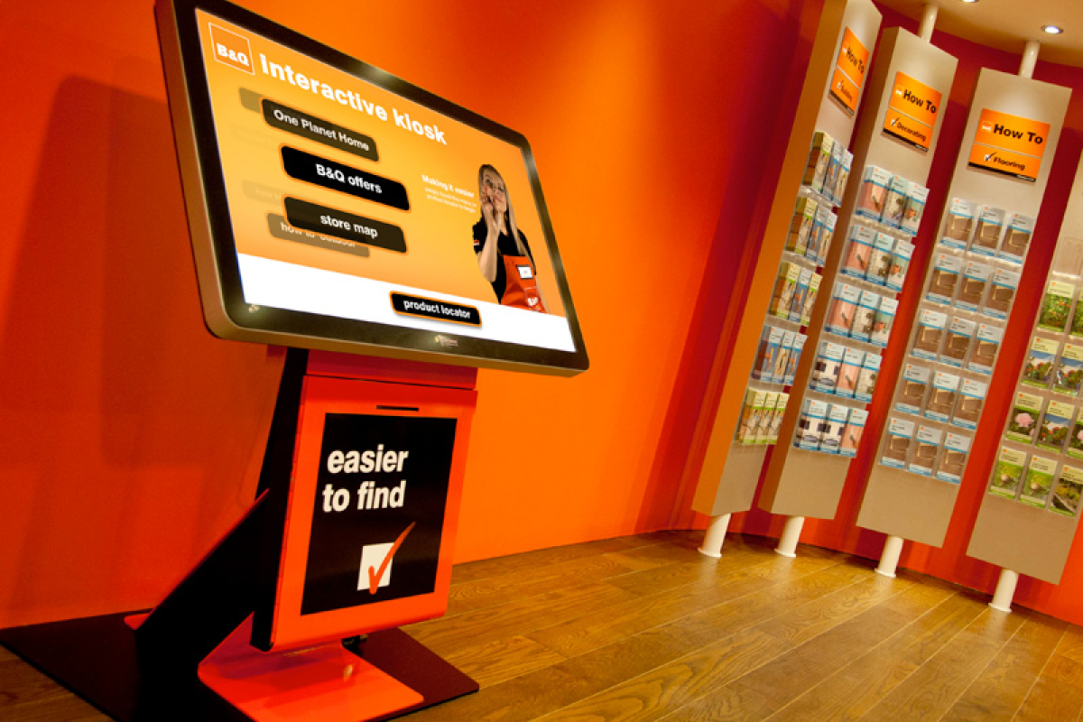


Integrated Customer Engagement platform for driving the new digital enterprise
Integrated solution for website, stores(POS),kiosk, call center using ATG commerce as foundation & customize across businesses ( B2B & B2C) , brands and countries
Cross Channel Enablement
Integrated Inventory visibility
Next Day Home delivery
Split and partial payments
Buy online and Pickup at store
Buy online Ship to store
shop in any way customer prefer
via shops, the internet or catalogues
Templatized Commerce service for other group Operating companies to leverage
customer context switching
B2B site roll-out
(tradepoint.com)
B2C site roll-out
Diy.com
Call centers and stores roll out
Customer centric retailing
In-Store Digital Experience
Responsive web design
Analytics driven personalization
Cross Sell/Upsell (Services + Products )
Social sharing
Ratings & reviews
Website ranking moved up an impressive 372 places to 18th spot
Notes:
customer context switching – profile – transfer to store – position – service moving across the enteriprise and create the value – Templatized Commerce service for other Op companies to leverage

Slide 44

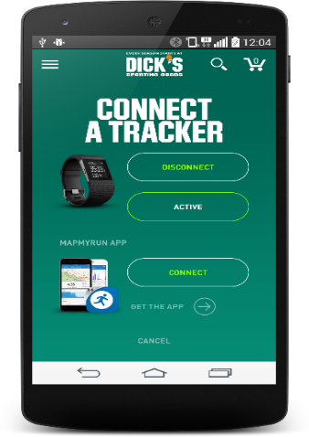
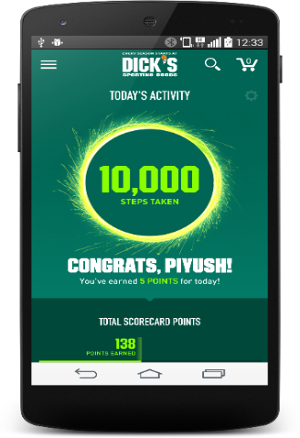
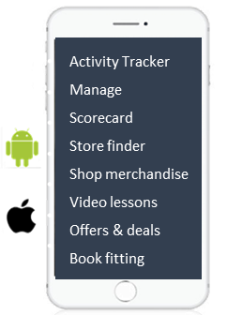
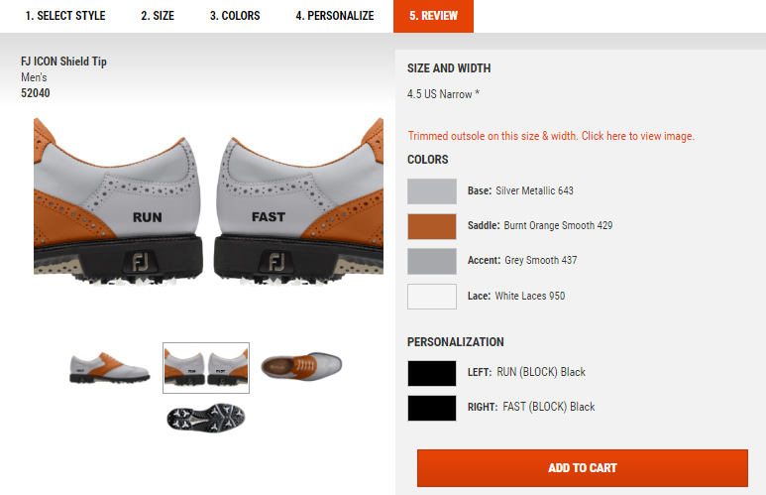



Omni-channel Commerce platform Re-architecting for multi tenancy
Multi-tenancy implementation
Gamification
Mobile app based activity tracker
Omni-Channel
architecture roadmap
Robust architecture supporting online & mobile shoppers
Commerce platform standardization
Re-platforming DSG Brand (GSI to WCS)
Golf Galaxy website WCS migration
Field & Stream- eCommerce Business launch
Native
mobile app
Customizable
products
Personalized customer experience,
while maintaining brand identity
200,000+
Downloads on Launch day
Single Code base
Faster time to market, Better Business agility, Easier Maintainability
CRM integration // Loyalty
~1 million downloads
Personalize your shoe
This has been one of the biggest technology launches in the history of our company .
This program was not just standing up a website but undertaking a true digital transformation
Went live !!
29th Jan 2017
- Vice President , Customer Innovation Technology

Slide 45






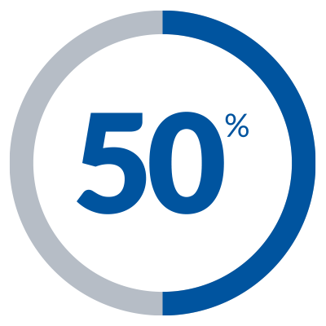
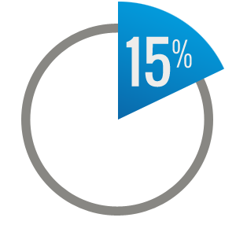


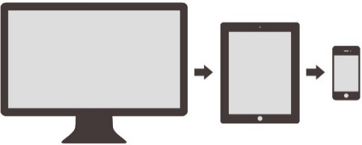






Building a Solid Foundation for Omni-Channel Commerce leverage Oracle ATG
Accelerated API Enablement for Legacy Modernization
Customers orders from multiple channels and devices are serviced through same set of API
97
API
11
Modules
6
Months
Code refactoring
Upgrade roadmap definition
Tech Debt refactoring
Ongoing enhancements
24/7 Support
Monitoring & support
Commerce
Platform
Assessment
Support &
Enhancements
97 API Service enablement across 11 Modules within 6 months
Key
Engagement
USER PROFILE
PRICING
INVENTORY
GIFT LIST
REST API
Services enablement
Complete
Site Redesign
Shopping Cart API
Checkout features API
Endeca Search Standalone API which bypasses ATG Commerce Pipeline
Pricing and Promotions API
ENDECA
PROMOTIONS
ORDER
ORDER HISTORY &
ORDER DETAILS
Seamless customer experience
PURCHASE PROCESS
SHOPPING CART
RENTAL SERVICES
Key Benefits
Significant Increase in
user traffic
Adaptive website
Increased Customer Experiences
More than
Reduction in
FTE
Reduction in
cost YoY
Reserve online pick up in-store
Reduction in Global defects post Go live
Through continuous improvements

Slide 46
US Largest home improvement retailer – Architecture evolution
Prior to architecture
transformation
Foundation and technology upgrades
Browse & Checkout applications Separation
APIGEE API
calls implementation
Browse
application
Checkout application
Browse and Checkout
APIGEE
Browse and Checkout
Tomcat
WCS 7
Expose services as API calls
WCS 5.6
WCS 7
Browse
application
Checkout application
Endeca Search
Endeca Search
Endeca Search
Not an upgraded eCommerce platform
Limited focus on customer-centric experiences
Basic ecommerce functionalities:
Search; Fulfilment and payment
Tomcat
WCS 7
Huge licensing cost because of high usage of ecommerce platform
Scalability and site availability
Application maintenance ease & Performance optimization
Expose services as API calls
Maintain common services across multiple channels (Mobile, Web, Kiosk etc..)
Expose Secure services and expose maximum comprehensive services across functionalities
Business Challenges
Endeca Search
Enhanced architecture to support dynamic business needs
Notes:
Home Depot

Slide 47
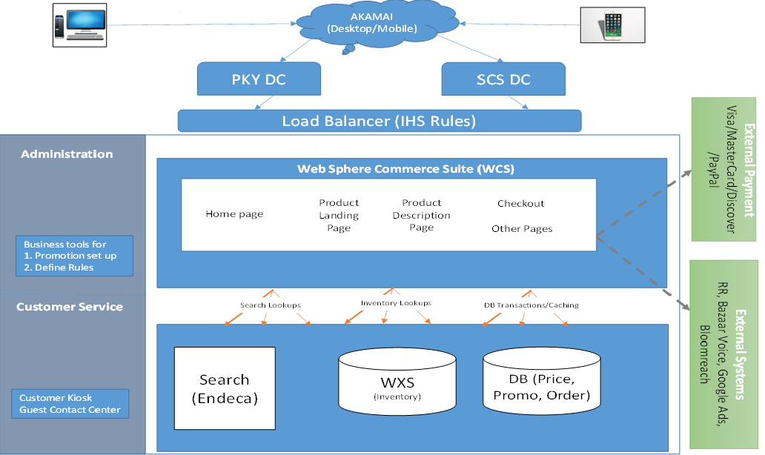
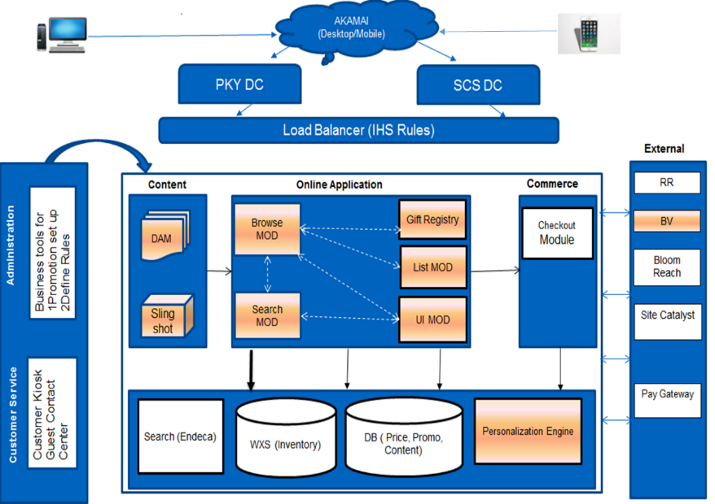
Leading General Merchandise Retailer, US
Initial launch
Transforming the Site Architecture
Post Transformation
Transformation
Transformation Journey timeline
Derived benefits
Phase I
Search : Endeca to SOLR migration ~11 months
Considerable reduction in WCS License and hardware Cost
40 Servers removed from WCS Cluster
Page load time had improved by about 25% (lean memory)
20% Page Performance Improvements
Search conversion jumped by approx. 10% - 12%
New apache servers to be 30-40% more efficient than WCS servers
Phase II
Browse application migration ~ 9 months
Phase III
Guest / User Account Mgmt. migration – ~6 months
Phase IV
Cart & Checkout. migration – In Progress (~ 10-12 months)
Notes:
Target

Slide 48
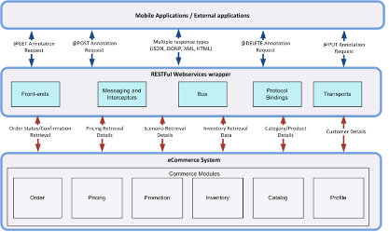
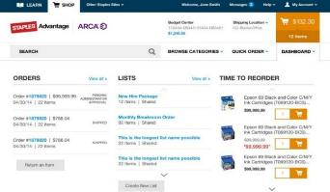

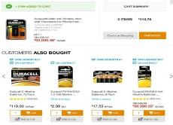

Large office supplies specialty retailer in US – API based Architecture evolution
Key Highlights
New Design . Better Experience.
Adaptive design : Consistent experience across desktops, mobiles and tablets
Personal dashboard with orders, shopping lists and approval mechanism
“My Deals” highlights the personalized best savings opportunities
Streamlined checkout
API Services based architecture leveraging WCS REST APIs for commerce functionality
End to End customer experience for mobile application and online site
Adaptive design using UI front end templates (using AngularJS, HandlebarJS)
Custom built special offer business admin tool using MustacheJS
My Dashboard
My Deals
Order Approvals Status
( B2B Approval)
Time to reorder notifications
Notes:
Staples

Slide 49
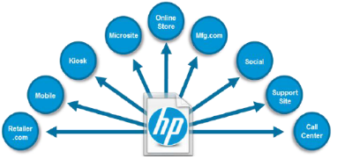
Large PC Manufacturer in US – Commerce as a Service architecture
- Exposing WCS Secured Shopping Cart as service to provide order capture facility to disparate ecommerce applications
- Exposing a Secured and Compliant Payment interface in WCS as a service to take payment from subscription programs
Architecture Flow
Rest of World
Customer
North America
Aggregator & Cart Transfer Partner
3
Aggregator & Cart Transfer Partner
EZBuy/Kelkoo
2
Catalog, Pricing, Availability Feed
SureSupply Site
Catalog, Pricing, Availability Feed
2
Google - Channel Intelligence
4
Order/Cart passed to Reseller
via Partner
Order/Cart passed to Reseller
via Partner
4
Catalog, Pricing,
Availability Feed
1
Order/Cart passed
to Reseller
Order/Cart passed
to Reseller
1
Catalog, Pricing,
Availability Feed
Customer completes
checkout at Reseller Site
5
Customer completes
checkout at Reseller Site
Resellers
(examples below)
Customer
Resellers
(examples below)
HP Shopping
TonerJet
HP Shopping
Best Buy
Cartridges Direct
Supplies Shopping
Staples
Office Depot
Notes:
HP

Slide 50
Thank You !!

